Slide 1
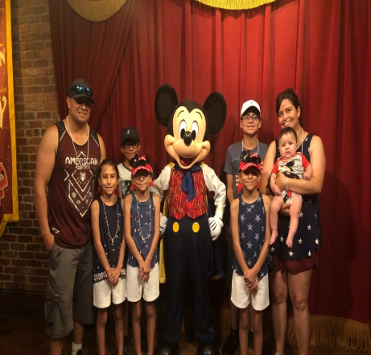
Mrs. Bessie Pacheco
The Basics!
Hi! My Name is Mrs. Bessie Pacheco! I am 33 years young! I live in Fort Stockton with my husband Chris. We have 5 wonderful kids; Diego, triplet girls-Leah, Lilly and Larissa and our baby Isaiah ! ☺ I will be your child’s 1st grade Reading & Social Studies teacher for the 2018-2019 school year! This will be my 11th year teaching. I taught Kindergarten for 9 years. This will be my second year as a 1st grade teacher & I am excited to make this my best year yet!
MY CHILDHOOD!
I grew up here in Fort Stockton, Tx where I attended Comanche Elementary, Intermediate, Middle School and graduated from High School in 2003! My parents are Ramiro and Esmeralda Valdez. I have one brother Alvino and 2 sisters Becky and Bessica (my twin)!
MY FAVORITES!
Food: Enchiladas
Movie: P.S. I Love You
Book: The Fault in our Stars
Color: Purple
Drink: Sweet Tea or Dr. Pepper
Season: Summer
Sports: Football (Go Cowboys!)
Fast Food: Subway
Singer: Ellie Goulding
Hobby: Camping
Subject: Reading
Store: Hobby Lobby
Dessert: Cake
Candy: anything chocolate ☺
Restaurant: local-Tacos OJ; away-Olive Garden
Flower: Roses
MY EDUCATION!
In May of 2008, I graduated with a Bachelors of Science in Education from Angelo State University in San Angelo, Tx. Go Rams!
CONTACT ME!
Email: bessie.pacheco@fsisd.net
Class Webpage: www.fsisd.net
School Phone Number: (432)336-4161 You can also write a note in your child’s agenda!

