Slide 1
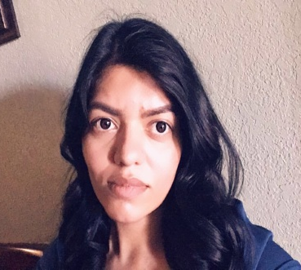
Miss Damaris Ruvalcaba
The Basics!
Hello. My Name is Miss Ruvalcaba. I will be your child’s 1st grade Math & Science teacher for the 2018-2019 school year! This will be my 1st year teaching. I am excited to be your child's first grade teacher!
MY CHILDHOOD!
I grew up in El Paso, TX and recently moved here. I have one brother and one sister.
MY FAVORITES!
Food: Suchi
Movie: Penelope Book: Pride & Prejudice
Color: Blue
Drink: Sweet Tea
Season: Fall
Fast Food: Whataburger
Singer: Jesse & Joy
Hobby: Reading
Subject: Math & Science
Store: Ulta
Dessert: Chocoflan
Candy: Snickers
Restaurant: Toro Bronco
Flower: White Roses
MY EDUCATION!
I have a Bachelor’s Degree in Civil Engineering from University of Texas at El Paso.
CONTACT ME!
Email: damaris.ruvalcaba@fsisd.net
Class Webpage: www.fsisd.net
School Phone Number: (432)336-4161 You can also write a note in your child’s agenda!

